Slide 1

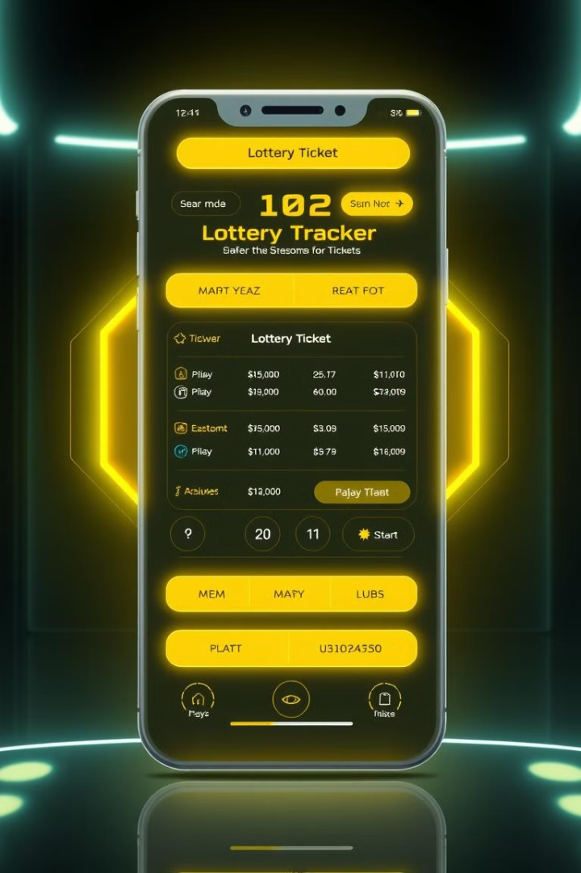
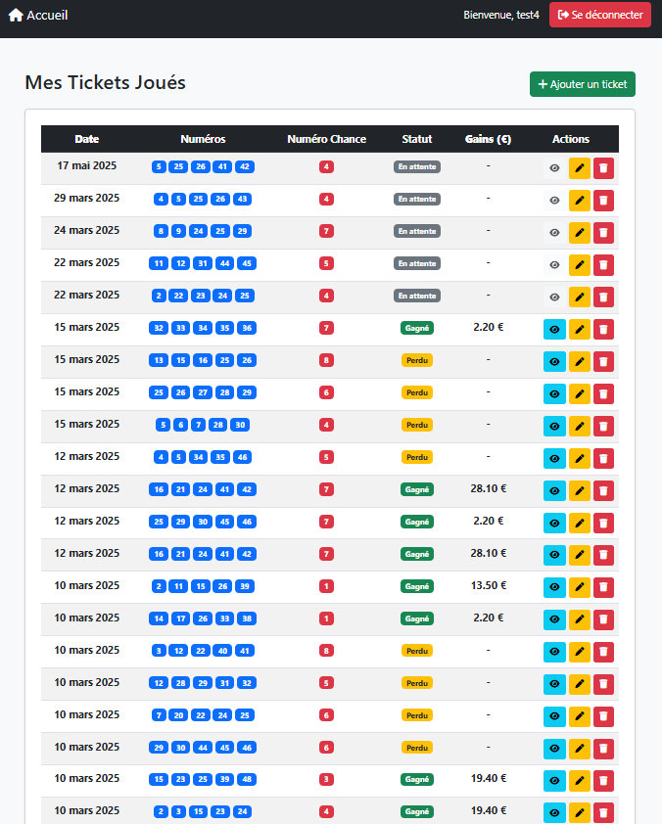
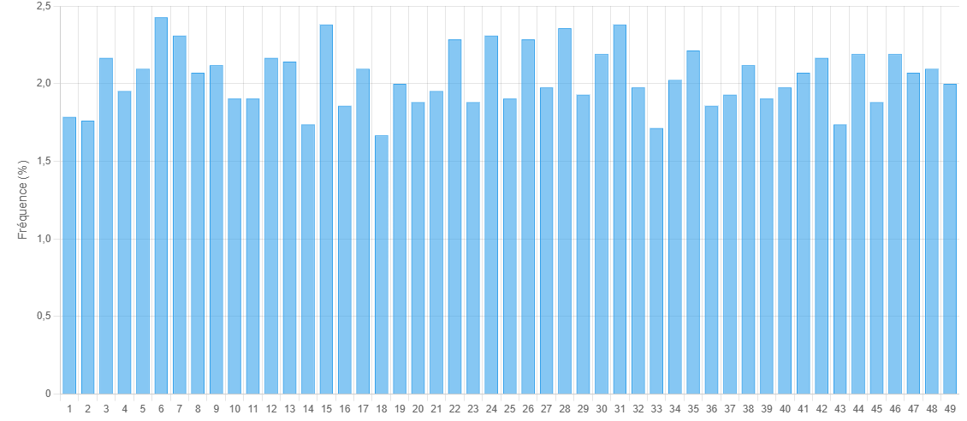
Loto Tracker API - Portfolio 2025
A presentation of the Loto Tracker API in Java Spring-Boot
Stéphane DINAHET
Holberton School RENNES

Slide 2

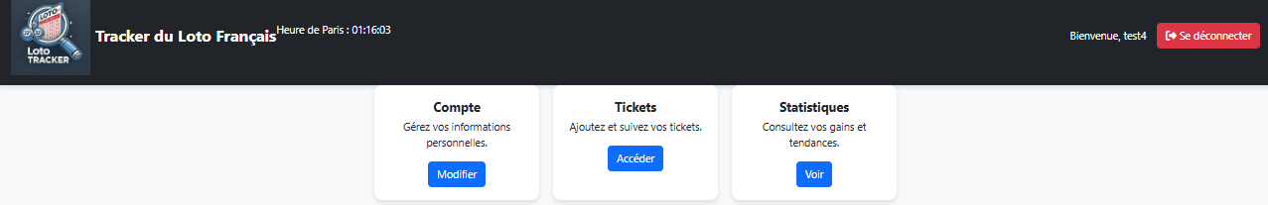


Project Overview
1
Secure Authentication
2
Ticket Management
JWT authentication for user management.
Submission and verification of lottery tickets.
3
Automated Comparison
4
Real-time Calculation
Automatic comparison with official FDJ results.
Real-time calculation of winnings.

Slide 3





Development Process
1
Planning
Feature definition and technical research.
2
Backend and Frontend Development
Implemented with Spring Boot
3
Database Integration
MongoDB & SQLite for storage.
4
Testing & Deployment
CI/CD pipeline with GitHub Actions & Docker.

Slide 4


Technical Architecture
Backend
Authentication
Storage
Automation
Package
Spring Boot
Secure JWT (blacklist, short expiration).
SQLite for tickets & users, MongoDB for history.
Scraping official loto results every 30 minutes and calculation gains every 30 seconds.
Docker of Project
and integration test with github actions

Slide 5
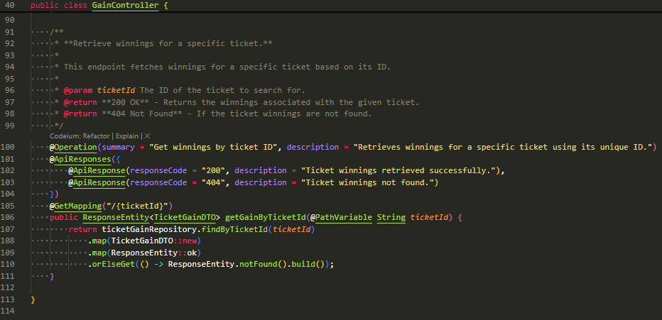
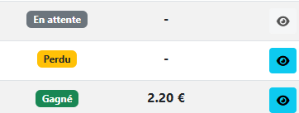

Slide 6
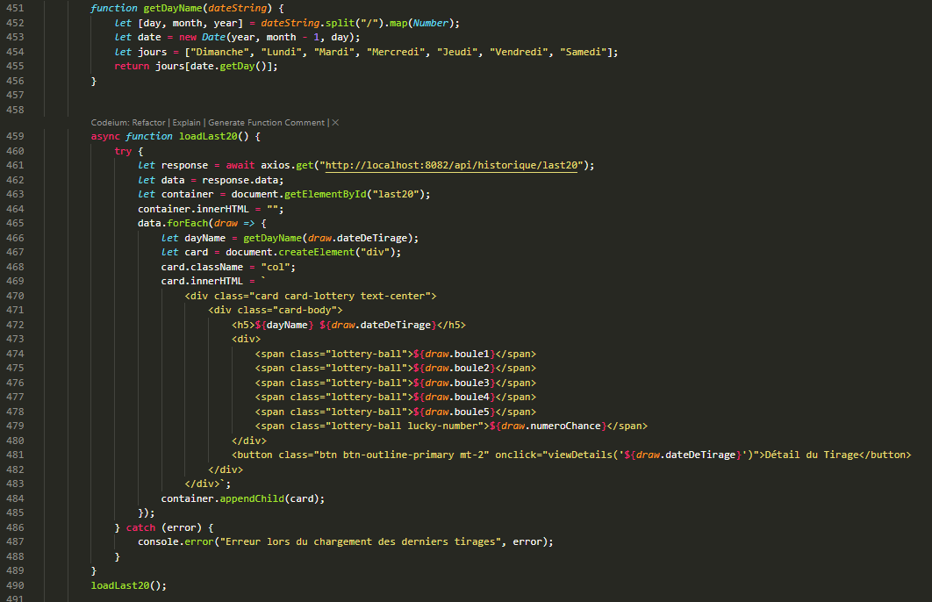
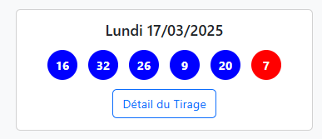

Slide 7
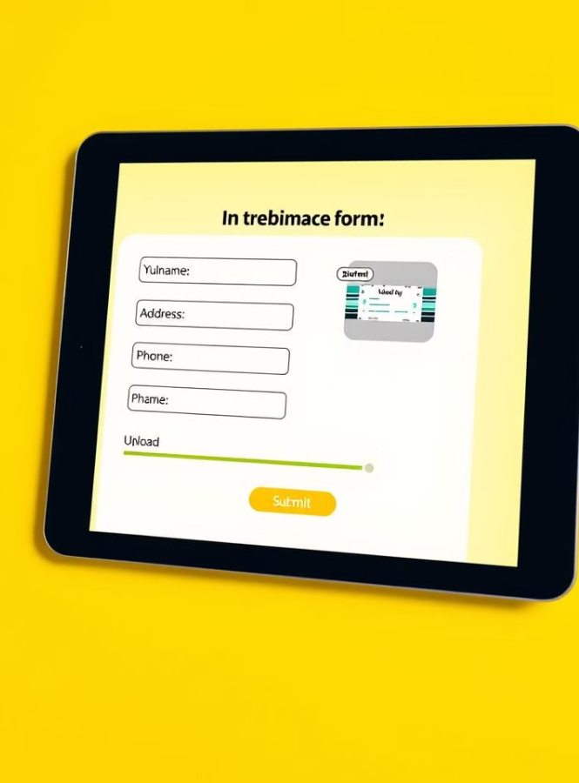
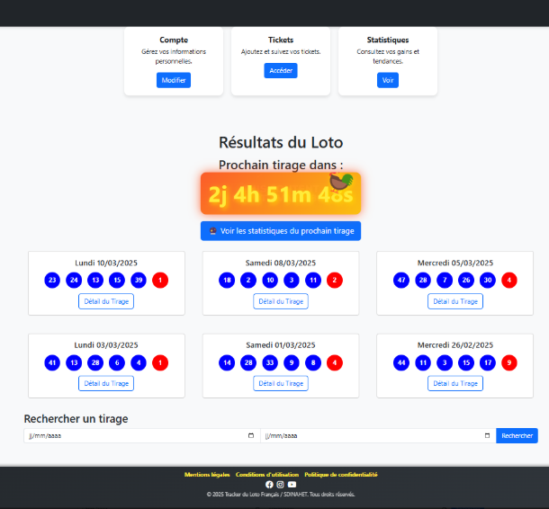
MVP Demonstration
User Registration
Show user registration and authentication.
Ticket Submission
Submitting and verifying lottery tickets.
Real-time Winnings
Real-time winnings calculation.
API Interaction
API & database interactions.

Slide 8
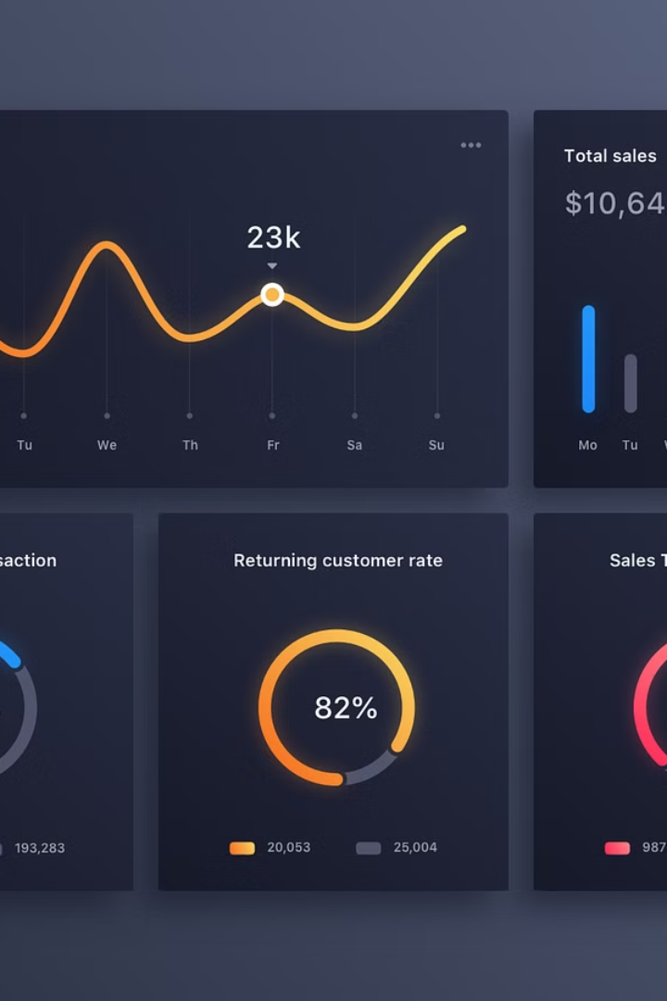
Performance & Results
200ms
Average API Response
Average API response time.
98%
Request Success
API request success rate.
250+
Tickets Analyzed
Total tickets analyzed.
10
Critical Bugs
Critical bugs resolved.

Slide 9



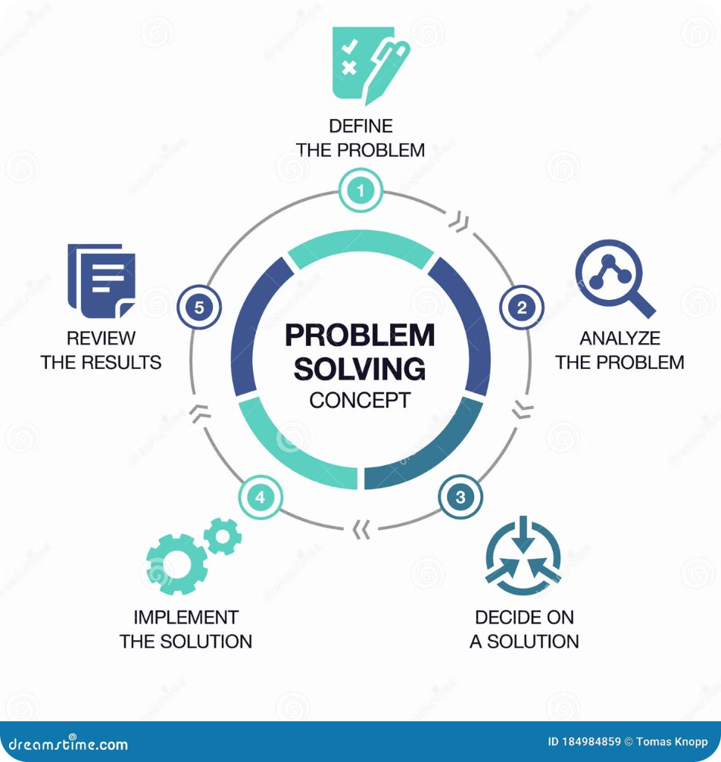





Key Challenges & Solutions
JWT Issues
Implemented token in cookies.
Database Scaling in future
Migration SQLite to PostgreSQL.
Slow Comparison
Optimized queries
Security Issues
Configured Spring Security

Slide 10





Lessons Learned
Efficient database management is crucial.
Secure authentication requires proactive measures.
CI/CD automation saves time.
Early user testing improves quality.

Slide 11




Conclusion & Next Steps
Thank You!
2
Stable API
1
Project Success of MVP
3
SDINAHET/Loto_API
MVP developed & tested successfully with Github actions. Next steps: Deployment on a stable hosting platform.
Project Repository: GitHub Repository CI/CD Actions Landing Page

